Slide 1


AngularJS.
Debugging
NADZEYA SHEDAVA
OCTOBER 21, 2015

Slide 2
COURSE AGENDA
1. INTRO
Angular features
Bootstrap a project
2. CONTROLLERS & MARKUP
Organize code in controllers
Use build-in directives to control view
3. SERVICES
More domain logic to services
Facilitate single-responsibility principle
4. DIRECTIVES
Create own custom elements
Observe changes
Handle events
5. ROUTING
Create true SPA with routing
Use built-in functionality of Angular routing
6. SECURITY
Security scenarios
Work with access tokens
React to 401
Cross-site scripting attacks
Correct bind HTML
7. DEBUGGING & DIAGNOSTICS
Diagnostic and debugging
8. ANGULAR UI
Search for ready solutions
9. FORMS
Enjoy two-way binding
Validate your user input
Show messages
10. TESTING
Test controllers, services and directives
Do full end-to-end testing

Slide 3
MODULE AGENDA
1
Alerting service
2
Interceptors
3
Tools

Slide 4
TOOLS
AngularJS Batarang
ng-inspect
Angular watchers
Console tips

Slide 5
INTERESTING INFORMATION
Exceptions
Rejected promises
Significant events

Slide 6
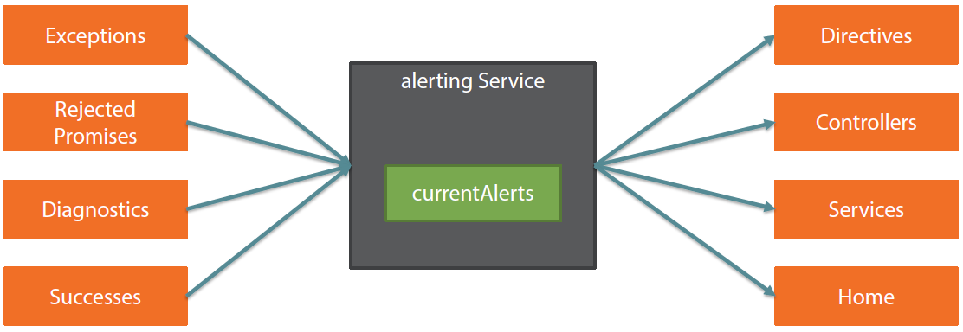
ALERTING SERVICE

Slide 7
DECORATING
Wrap a service to add some behavior
Extend / modify existing behavior

Slide 8
DEMO
{{ Alert service }}

Slide 9
Q & A

Slide 10
Thank you
for your attention :)

